Slide 1
CBI Web Portal User manual
Kolawole, Oni SPDC-UIO/G/PB

Slide 2
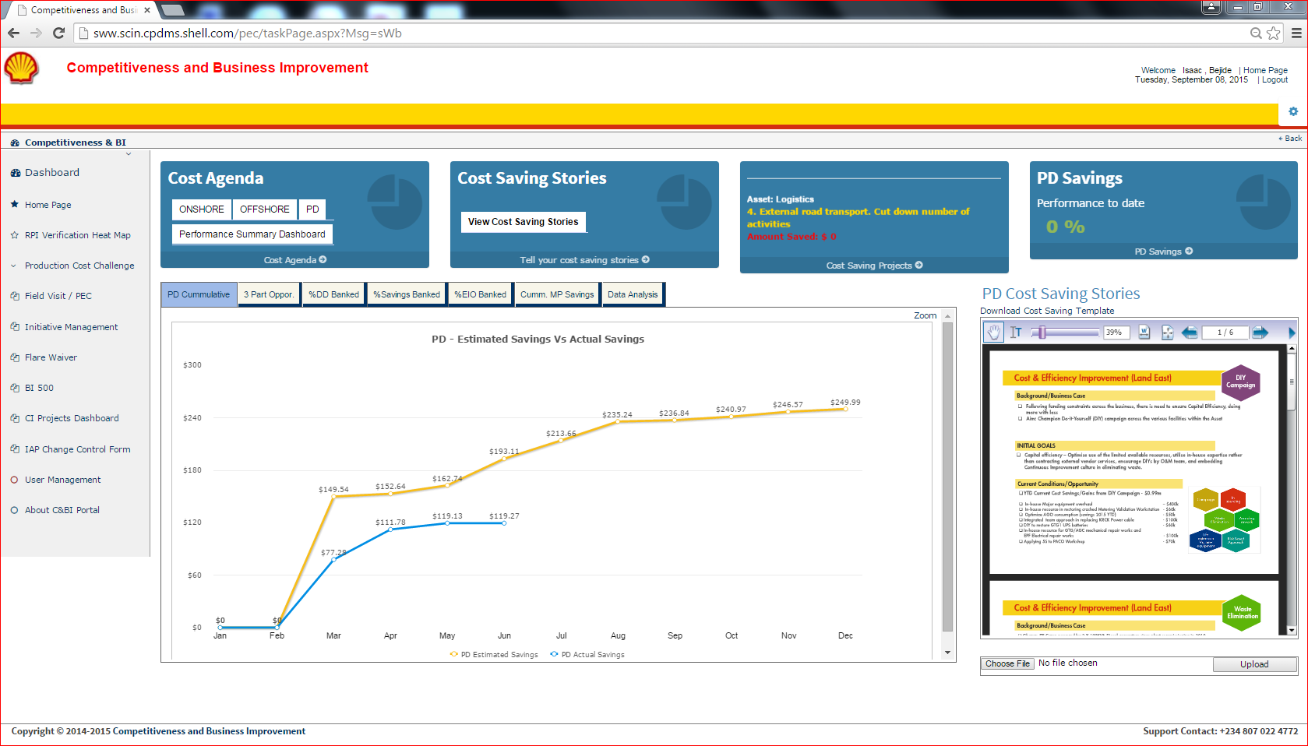
C & BI Home page components
Cost Agenda
Cost saving projects, scrolling
Other applications
Cost Saving Stories section
Support
Deep Dive, Deep Dive Opportunity, Efficiency Improvement Opportunity Charts

Slide 3
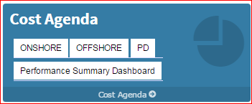
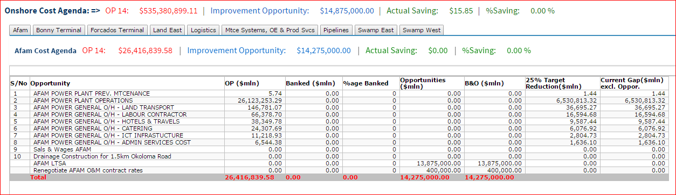
Cost Agenda – Onshore, Offshore and PD
Click on the ONSHORE button under the Cost Agenda,
Asset under Onshore are displayed with buttons.
Click on the button you want to see cost saving projects.
The projects are listed, as shown above, with all the saving opportunities.
Repeat same steps for other buttons under Cost Agenda.

Slide 4
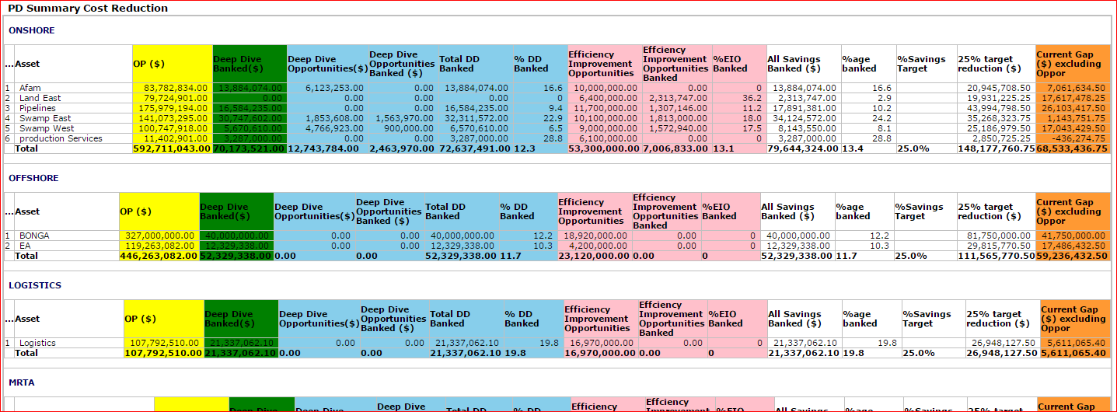
Cost Agenda – PD Summary
Performance Summary generates a summary overview of the savings performance against plan(OP). Projects under each asset in an asset area are rolled up to their respective assets and total sum of the performance are calculated for the asset area.
Click Performance Summary Dashboard

Slide 5
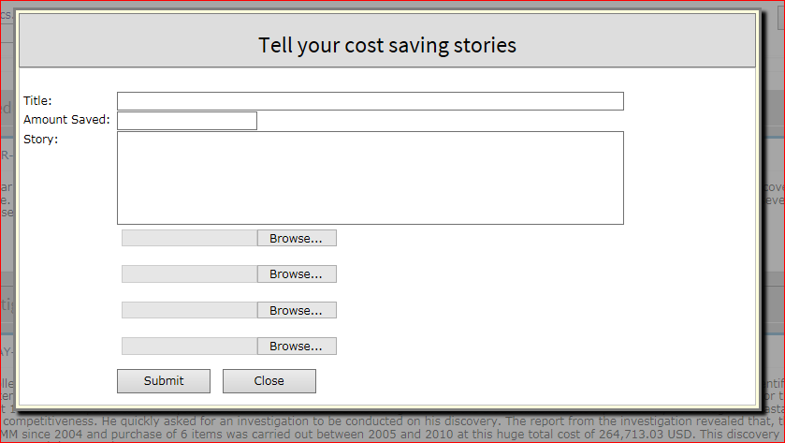
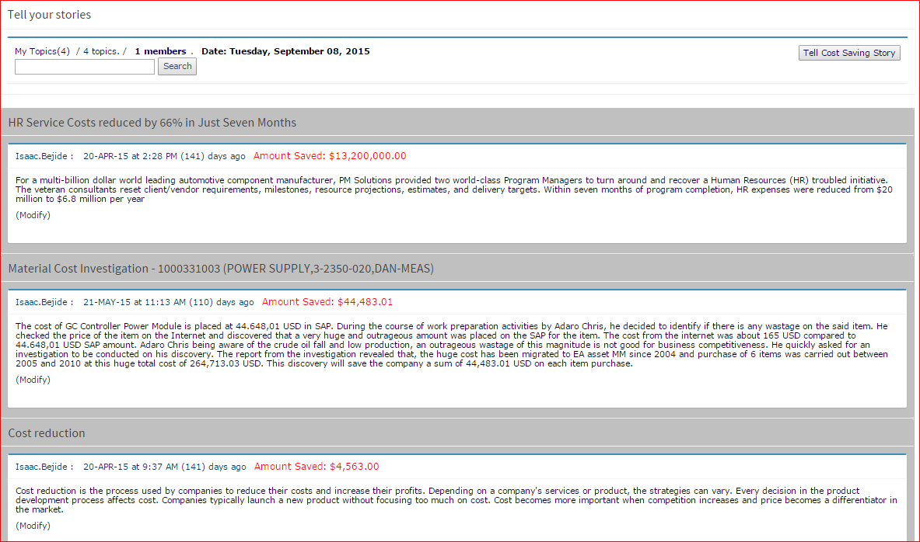
Cost Saving Story
To tell Cost Saving Stories:
Click View Cost Saving Stories.
On the Cost Saving Stories page, click Tell Cost Saving Story
A popup window pops up a form to fill your saving stories and add maximum of 4 images.
Then click Submit button

Slide 6
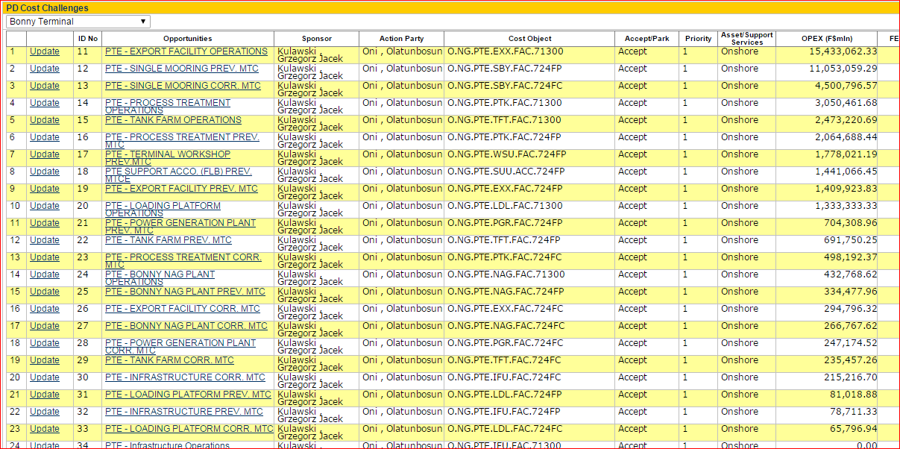
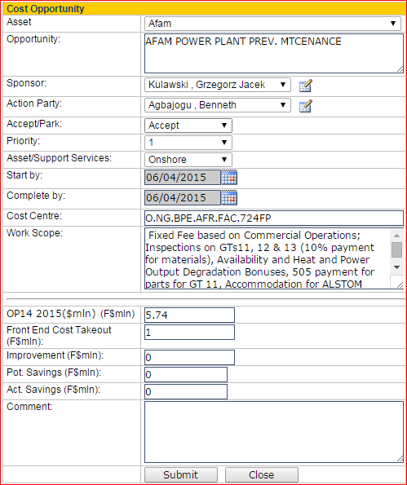
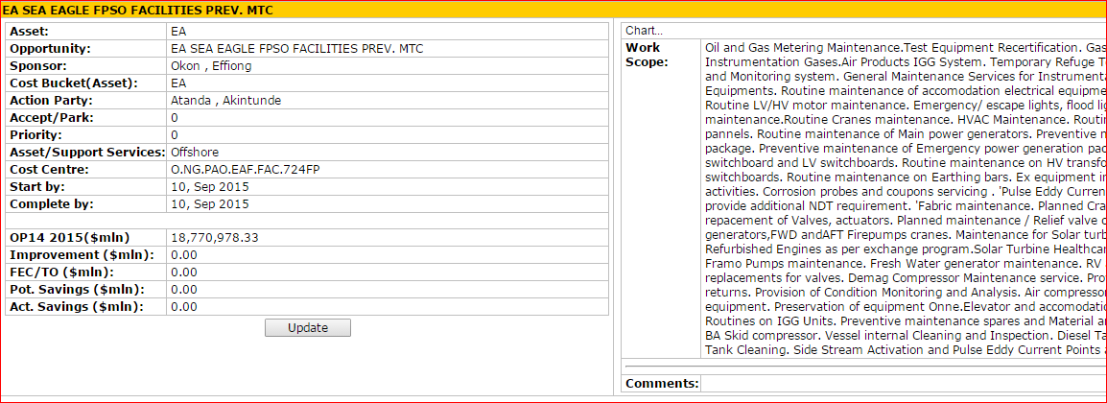
PD Cost Challenge
Data are uploaded into the CBI Performance monitoring tool, using the Production Cost Challenge option on the web portal.
Click production Cost Challenge.
Select your Asset. The preloaded projects from your asset are displayed.
Click Update button to make changes.
Click the project to display project details.
Update Project
Project details

Slide 7
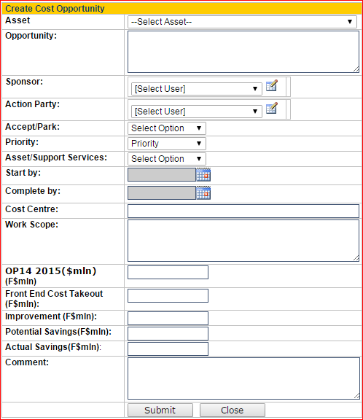
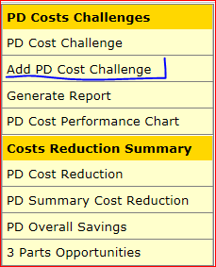
Add New Project.
Click Add PD Cost Challenge.
Select your Asset.
Fill the form.
Click Submit button.

Slide 8
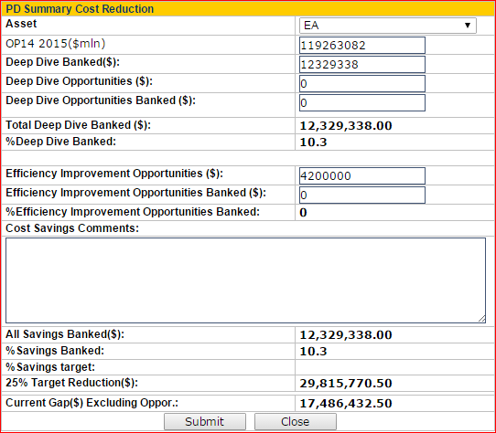
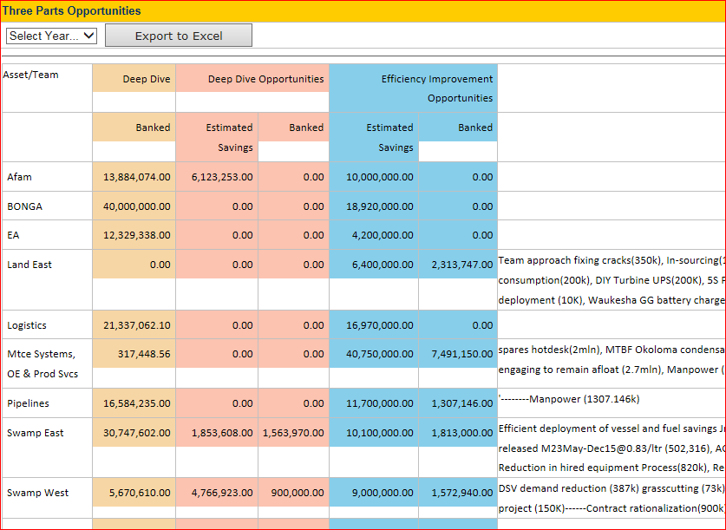
PD Cost Challenge Reduction and 3 Parts Opportunities
Click PD Summary Cost Reduction menu
Select your Asset. If data has been filled for the asset, the data are called up for update.
Click Submit button.
The data here is used to display Three parts opportunities report.
Click 3 Parts Opportunity menu to view report.
Click Export to Excel to download the report.

Slide 9
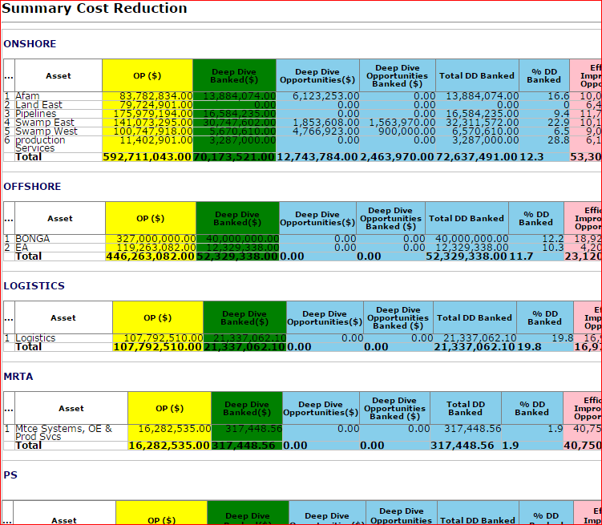
Summary Cost Reduction Report
Click PD Summary Cost Reduction menu
Select your Asset. If data has been filled for the asset, the data are called up for update.
Click Submit button.

Slide 10
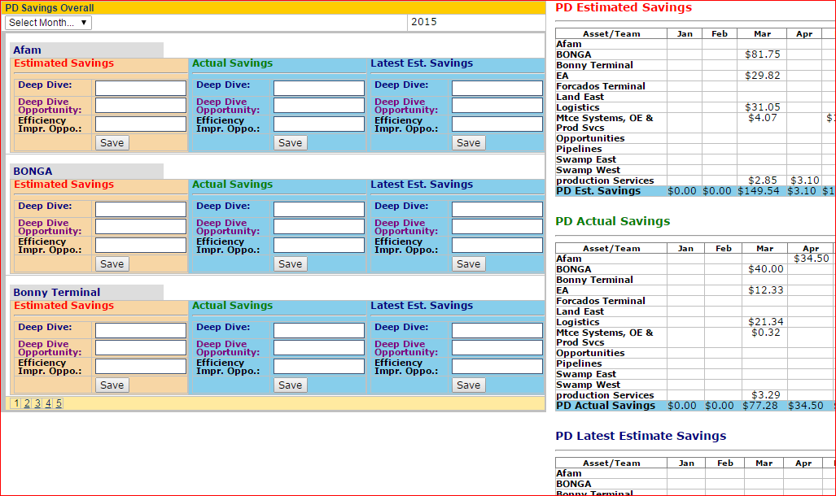
PD Overall Savings
Click PD Overall Savings menu
Select the Month you want to update
Enter the values for Deep Dive, Deep Dive Opportunity and Efficiency Improvement Opportunity for each asset.
Click Save button to submit.
The tables for PD Estimated, Actual and Latest Estimate Savings are updated.
Note: This data is used to plot the graphs in the center view of the CBI website.

Slide 11
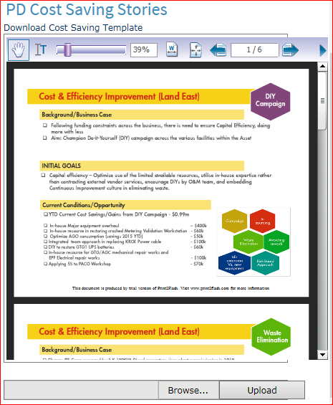
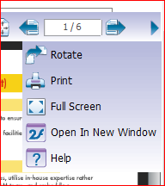
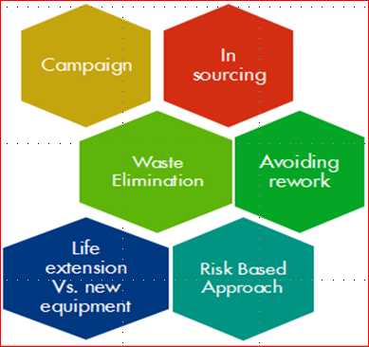
Cost Saving Stories
Cost Savings Stories are in two format on CBI website.
The PD Cost Saving Stories here is used for presentation.
Click Download Cost Saving template, (a Power Point file)
Pick an item from the six hexagonal options below
Use the option as your cost saving story Head Line
Enter your cost saving stories under each section
Forward your stories to the CBI team.
The CBI team uploads your Saving stories to the portal

